Slide 1
Mastering NT Greek
6. Preping for Prepositions
By Ted Hildebrandt © 2003
Baker Academic

Slide 2
Warm-ups

Slide 3
PAI Verb Paradigm Rap
λύω λύομεν
λύεις λύετε
λύει λύουσι(ν)

Slide 4
2-1-2 Paradigms - Chant this
2 1 2
λόγος γραφή ἱερόν
λόγου γραφῆς ἱεροῦ
λόγῳ γραφῇ ἱερῷ
λόγον γραφήν ἱερόν
λόγοι γραφαί ἱερά
λόγων γραφῶν ἱερῶν
λόγοις γραφαῖς ἱεροῖς
λόγους γραφάς ἱερά

Slide 5
Memory Verse -- Jn 1:1
Ἐν ἀρχῇ ἦν ὁ λόγος,
in the beginning was the word
καὶ ὁ λόγος ἦν πρὸς τὸν θεόν,
and the word was with God
καὶ θεὸς ἦν ὁ λόγος.
and the word was God

Slide 6
What is a preposition?
Usually small words that relate two words or ideas in time, space or logic
He went into the house.
He went before the meeting.
He came because he left his book.
Adverbial: He went after the game.
Adjectival: Pick up the book on the table.

Slide 7
Prepositional phrases
String of closely connected words
Prep. + Object of Prep.
upon + the roof
beside + the tree
after + the song

Slide 8
Casing the prepositions
Each preposition has a favorite case (two or three) that it takes.
Do not use the keywords (of [Gen]; to/for/at [Dat]) with the cases when they go with a preposition.
Prepositions often extend, specify or develop an aspect of the accompanying case

Slide 9
Remember another to look at case
Accusative Dative Genitive
Motion to/into in Motion away from
in

Slide 10
One case prepositions: Genitive
ἀπό = from, of, because of, by + Genitive
Genitive has separation idea
ἀπὸ τοῦ νόμου -- from the law
ἀφ’ ὑμῶν -- from you
ἀπ’ αὐτοῦ –from him
Note if a prep. ends in a vowel and is followed by a word that starts with a vowel and a rough breathing, the vowel of the prep. will drop out and often the preceding consonant will be changed.

Slide 11
One case prepositions (Gen.)
ἐκ – from, out of, of, because of + Gen.
ἐκ τῆς βασιλείας
out of the kingdom
ἐξ οὐρανοῦ -- from heaven
ἐκ and ἀπό overlap (ἐκ = from the midst; ἀπό from the edge [D&M]; and genitive of separation.

Slide 12
One case prepositions (Dat.)
ἐν -- in, on, at, when, among + Dat.
ἐν ταῖς καρδίαις
in the hearts
σύν – with + Dat.
σὺν τῷ ἀγγέλῳ
with the angel

Slide 13
One case prepositions (Acc.)
εἰς -- into, to, in, among, for + Acc.
εἰς τὴν Πέτρου
Into Peter’s house
What is the difference between exegesis and eisogesis?
πρός – to, toward, with + Acc.
πρὸς τοὺς μαθητάς
to the disciples

Slide 14
4-Two case prepositions
διά -- (Gen.) through, by, during
διὰ Ἰερεμίου τοῦ προφήτου
through Jeremiah the prophet
διά -- (Acc.) because of
διὰ τὸν λόγον
because of the word
δι’ αὐτόν –on account of him

Slide 15
4-Two case prepositions
κατά -- (Gen.) down, against
κατὰ τοῦ λαοῦ
against the people
κατά -- (Acc.) according to, during
ΚΑΤΑ ΙΩΑΝΝΗΝ
According to John
καθ’ ἡμέραν – during a day
κατ’ αὐτόν – according to him

Slide 16
4-Two case prepositions
μετά -- (Gen.) with
μετὰ Ἰησοῦ τοῦ Ναζωραίου
with Jesus of Nazareth
μετ’ αὐτοῦ – with him
μετά -- (Acc.) after
μεθ’ ἡμέρας ἕξ
after six days

Slide 17
4-Two case prepositions
περί -- (Gen.) for, concerning
περὶ τῶν δύο ἀδελφῶν
concerning the two brothers
περί -- (Acc.) around, about
περὶ τὴν ἀλήθειαν
about the truth

Slide 18
1-Three case preposition e]pi<
ἐπί -- (Gen.) on, over
ἐπὶ γῆς -- on earth
ἐπί -- (Dat.) on, at, against, on the basis of
πατὴρ ἐπὶ υἱῷ καὶ υἱὸς ἐπὶ πατρί
father against a son and a son against father
ἐπί -- (Acc.) on, to, toward, against
ἐπὶ τοὺς μαθητὰς αὐτοῦ
to his disciples

Slide 19
Prepositional Circle of Life
ἐπί on, over.
against
σύν – with
μετά -- with, after
περί
around,
about
ἀπό
From, of
πρός
to, with
εἰς into, to, in
ἐκ
out of, from
ἐν – in, at, when
διά
Through,
Because of
κατά
against, down,
According to

Slide 20
Elision
Prepositions ending in a vowel often drop the final vowel when it comes before a word that begins with a vowel.
δι’ ἐμοῦ = (διά + ἐμοῦ) through me
If there is a rough breathing mark on the next word, the final consonant may shift.
μεθ’ ἡμέρας after days

Slide 21
Proclitics and Compounds
ἐν, εἰς, and ἐκ are proclitics
Prepositions often compound with other words: direction, intensifiers
διά + βλέπω through + I see
I see clearly

Slide 22
Prepositions Moves Chant
ἐπί
περί
πρός
εἰς
διά
ἐν
ἐκ
ἀπό
κατά
σύν
μετά

Slide 23
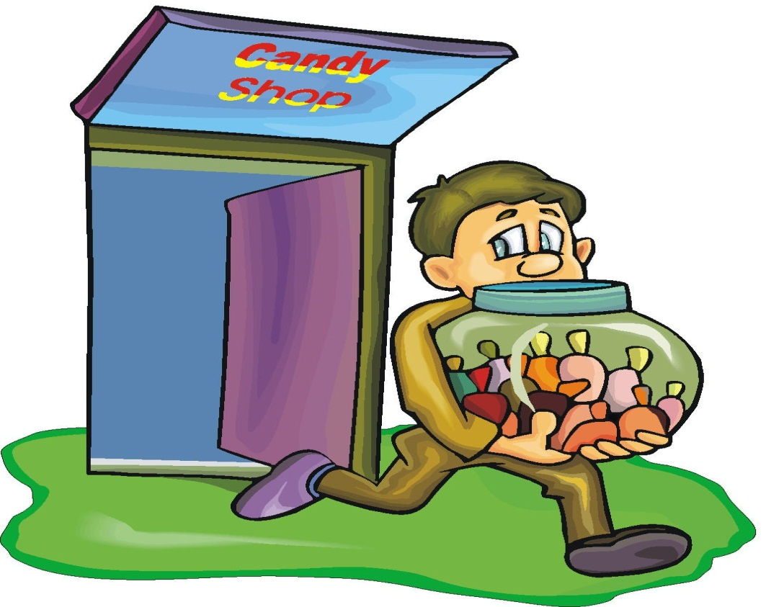
Chapter 6 Vocabulary
ἀπό (Gen.)
from

Slide 24
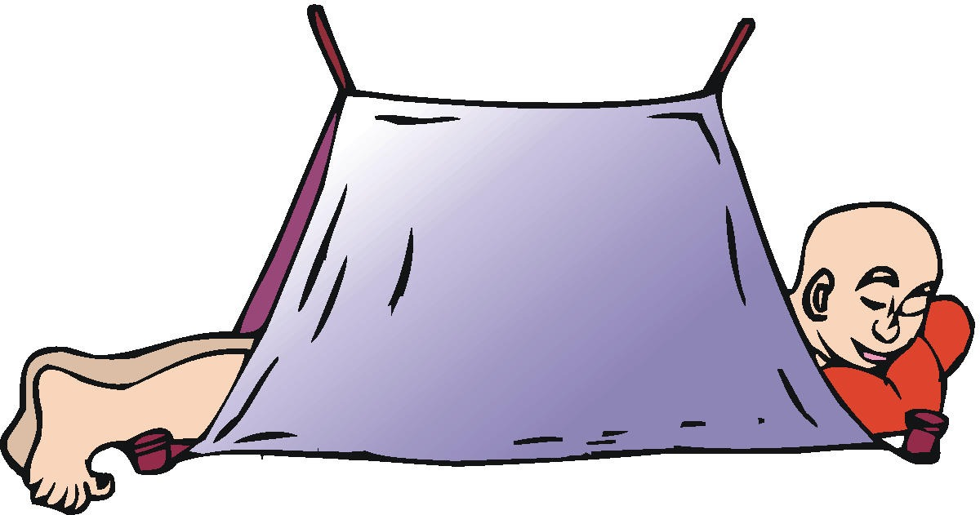
Chapter 6 Vocabulary
διά (Gen.)
through
διά (Acc.)
on account of

Slide 25
Chapter 6 Vocabulary
εἰς (Gen.)
into

Slide 26
Chapter 6 Vocabulary
ἐκ (Gen.)
out of

Slide 27
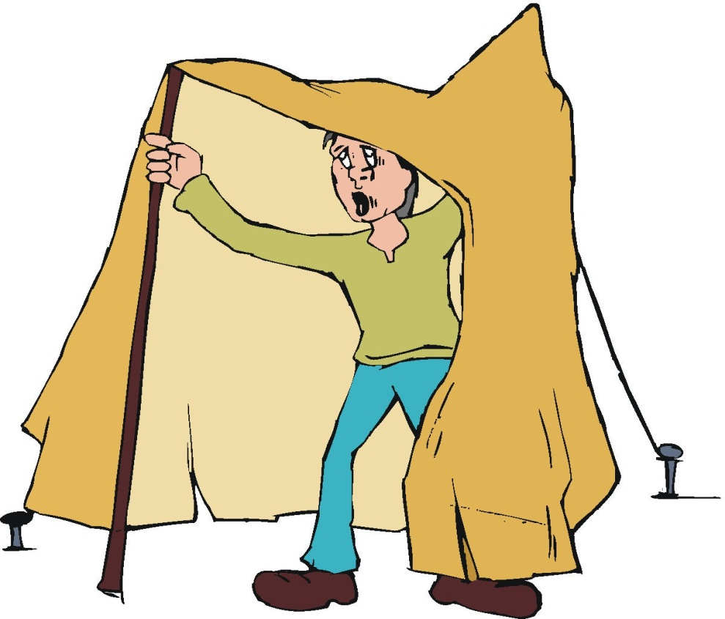
Chapter 6 Vocabulary
ἐν (Dat.)
in

Slide 28
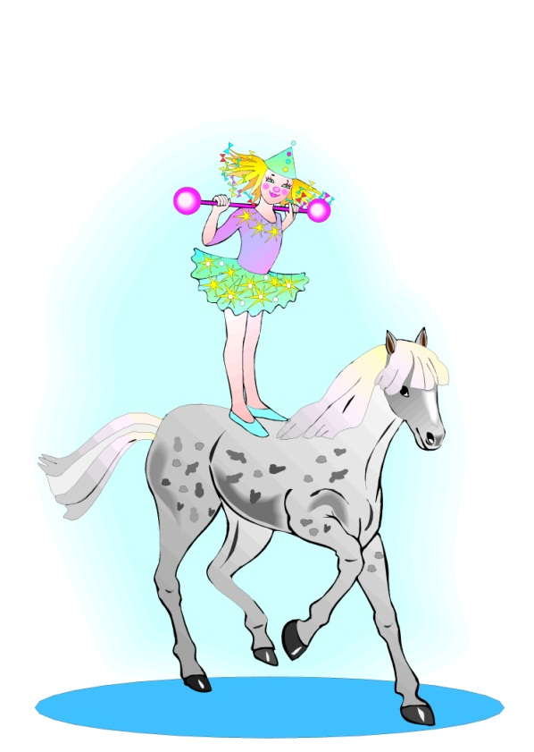
Chapter 6 Vocabulary
ἐπί (Gen.)
on, over
ἐπί (Dat.)
on, against, at, on the basis of
ἐπί (Acc.)
on, to, toward, against

Slide 29
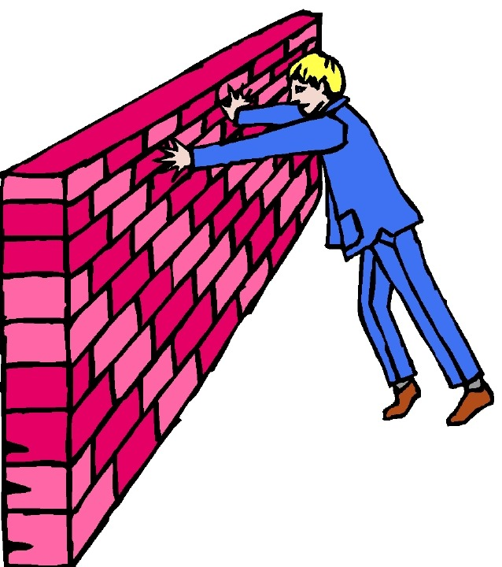
Chapter 6 Vocabulary
κατά (Gen.)
down, against
κατά (Acc.)
according to

Slide 30
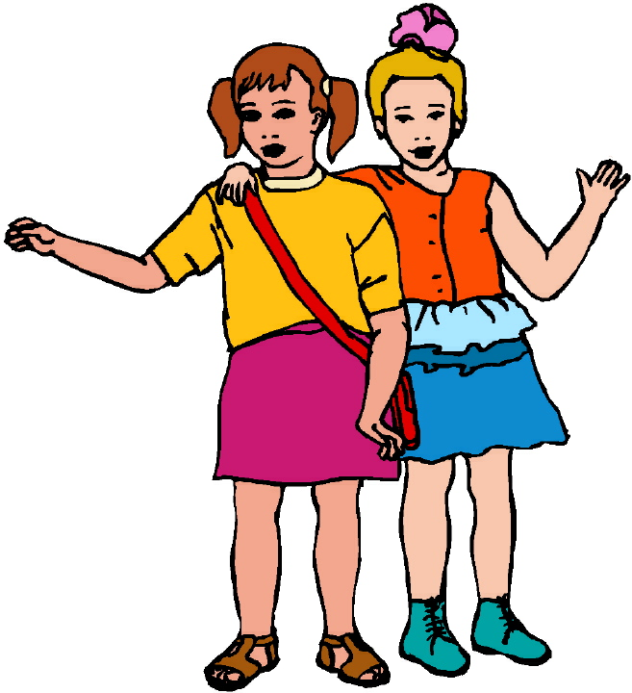
Chapter 6 Vocabulary
μετά (Gen.)
with
μετά (Acc.)
after, behind

Slide 31
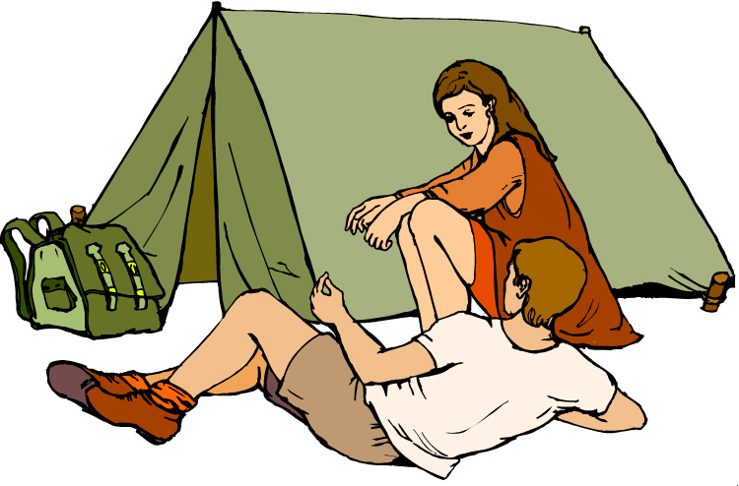
Chapter 6 Vocabulary
περί (Gen.)
about, concerning
περί (Acc.)
around, near

Slide 32
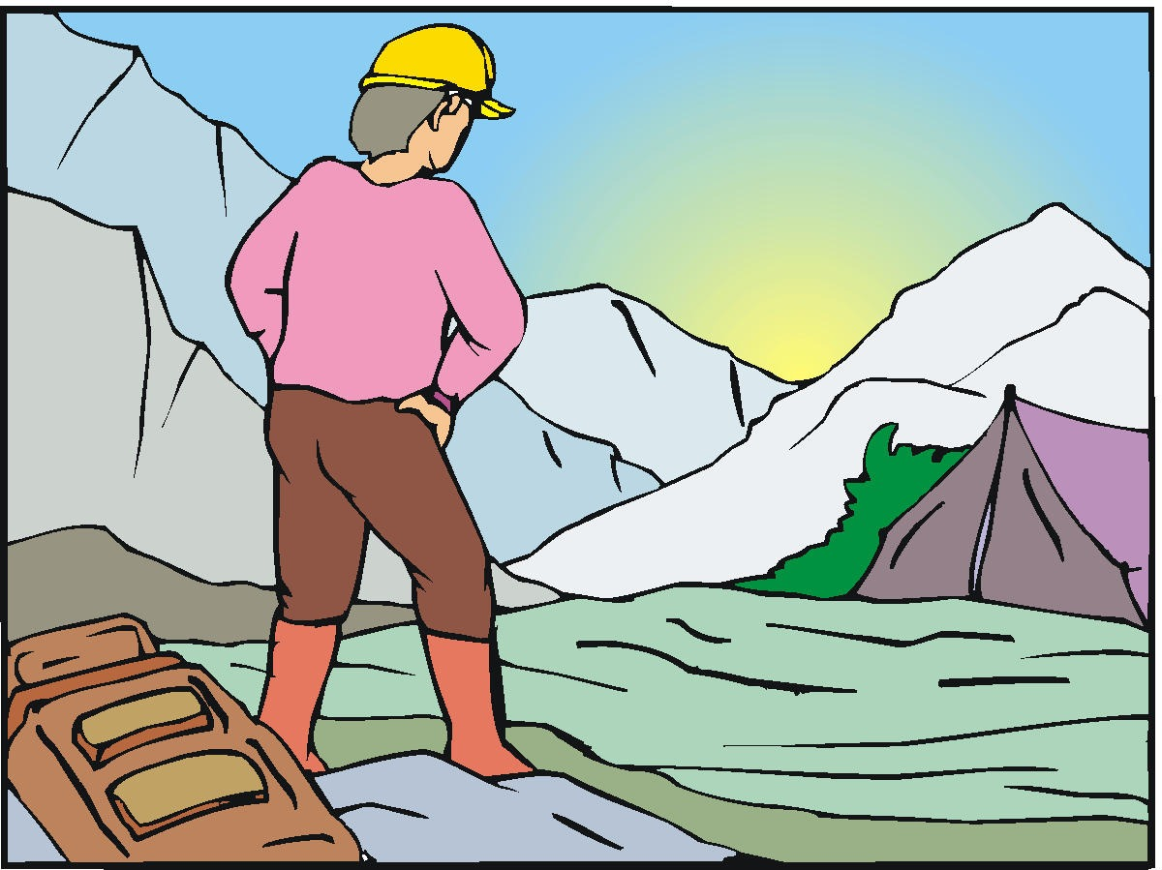
Chapter 6 Vocabulary
πρός (Acc.)
to

Slide 33
Ch. 1 -- Vocabulary
angel, messenger
ἄγγλος, -ου, ὁ
verily, truly
ἀμήν
man, humankind
ἄνθρωπος, -ου, ὁ
I
ἐγώ
God
θεός, -οῦ, ὁ

Slide 34
Ch. 1 -- Vocabulary
and, also, even
καί
heart
καρδία, -ας, ἡ
I say
λέγω
prophet
προφήτης, -ου, ὁ
Christ, Messiah
Χριστός, -οῦ, ὁ

Slide 35
Ch. 2 -- Vocabulary
brother
ἀδελφός, -οῦ?, ὁ
I hear, obey
ἀκούω
glory, fame
δόξα, -ης, ἡ
I have
ἔχω
world
κόσμος, -ου, ὁ

Slide 36
Ch. 2 -- Vocabulary
Lord, sir
κύριος, -ου, ὁ
word
λόγος, -ου, ὁ
Peter
Πέτρος, -ου, ὁ
son
υἱός, -οῦ, ὁ
Pharisee
Φαρισαῖος, -ου, ὁ

Slide 37
Ch. 3 -- Vocabulary
but, yet
ἀλλά
apostle, sent one
ἀπόστολος, -ου, ὁ
I see
βλέπω
for, then
γάρ
I know
γινώσκω

Slide 38
Ch. 3 -- Vocabulary
Jesus
Ἰησοῦς, -οῦ?, ὁ
I take, receive
λαμβάνω
I loose
λύω
heaven
οὐρανός, -οῦ, ὁ
I believe
πιστεύω

Slide 39
Ch. 4 -- Vocabulary
I love
ἀγαπάω
I write
γράφω
but, and
δέ
servant, slave
δοῦλος, -ου, ὁ
I find
εὑρίσκω

Slide 40
Ch. 4 -- Vocabulary
temple
ἱερόν, -οῦ, τό
people
λαός, -οῦ, ὁ
law
νόμος, -ου, ὁ
house
οἶκος, -ου, ὁ
as, about, how
ὡς

Slide 41
Ch. 5 -- Vocabulary
love
ἀγάπη, -ης, ἡ
truth
ἀλήθεια, -ας, ἡ
sin
ἁμαρτία, -ας, ἡ
kingdom
βασιλεία, -ας, ἡ
writing, Scripture
γραφή, -ῆς, ἡ

Slide 42
Ch. 5 -- Vocabulary
I raise up
ἐγέίρω
assembly, church
ἐκκλησία, -ας, ἡ
work
ἔργον, -ου, τό
disciple
μαθητής, -οῦ, ὁ
Hour
ὥρα, -ας, ἡ

